Slide 1
Coordinating Recovery Support for People with Disability
Notes:
NOTE TO FACILITATORS
The following slides provide you with a self paced walk through of the module, supported with speakers notes.
The package takes approximately 60 minutes to run, allow up to 25 mins for the presentation and 30mins for the group discussion activity
Notes are in standard format. Facilitator actions are in bold italics.
It’s a good idea to print out a “notes” version of the slide deck for your reference.

Slide 2
Objectives
Understanding how people with disability are disproportionately impacted before, during and after disaster and what this means for recovery planning and service arrangements.
Understanding emergency managements’ role in disability inclusive emergency and recovery planning - and the importance of working in partnership with people with disability, the services that support them and their representatives/advocacy organisations.
Identify action-oriented strategies to increase access, inclusion and support of people with disability in recovery.
Notes:
The Coordinating Support for People with Disability Module is designed to give participants a common understanding of the impact of disaster for people with disability. It emphasises both the strengths and support needs of people with disability and their capability to contribute to emergency management and recovery planning.
Emergency management and recovery planning has not traditionally included people with a disability.
For too long, disability has been kept in the too hard basket because government and emergency services have not had the methods, tools, and guidance on how to include people with disability. Coordinating support for people with disability needs to be a key consideration in recovery planning.
Australia’s National Strategy for Disaster Resilience and National Disaster Risk Reduction Framework invite shared responsibility with individuals and communities. But we haven’t had the tools to include people with disability and the services that support them in emergency and recovery planning. Research in Australia led by the University of Sydney is helping to address that gap (for more information: www.collaborating4inclusion.org)
This module will raise awareness of the issues and provide direction and strategies for the development of disability inclusive emergency planning (As per Australia’s Disability Strategy 2021-31) by promoting the importance of including people with disability in planning so that their support needs are identified and planned for during an emergency and throughout recovery.

Slide 3

Meet Garry
Notes:
ACTION: You need to be in ‘slide show’ view to activate the link
Video: https://www.youtube.com/watch?v=HpzKSyL1E5g
Video length 3:20
Gary Matthews woke up on the morning of February 15, 2008, to discover his flat was flooded.
Emergency services came to rescue him, but they couldn’t take his wheelchair.

Slide 4
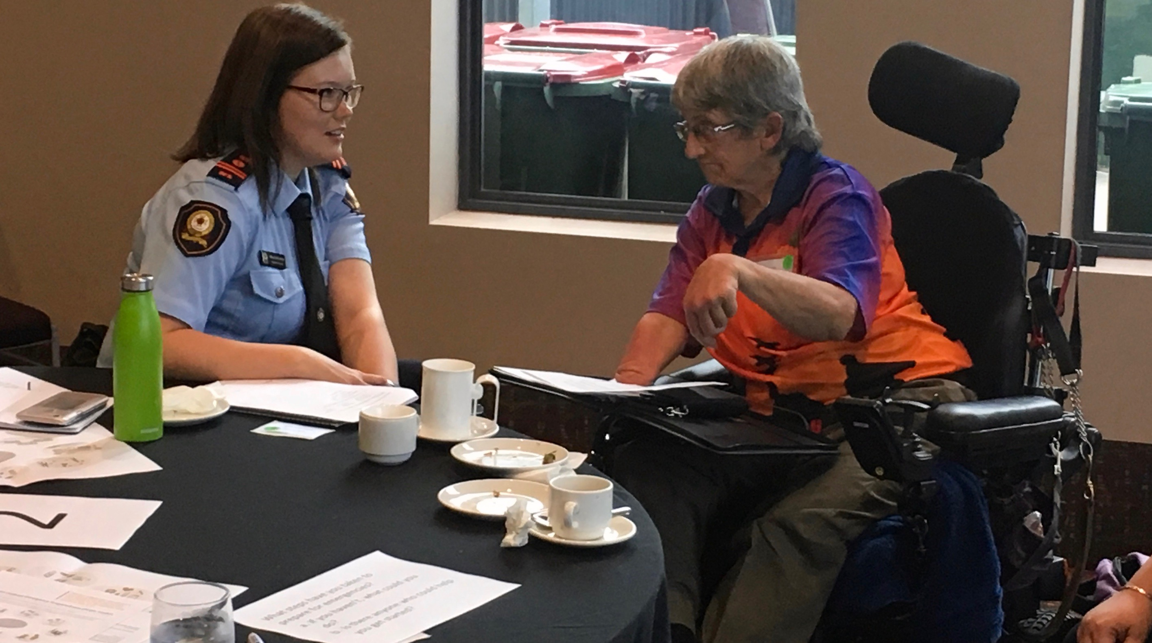
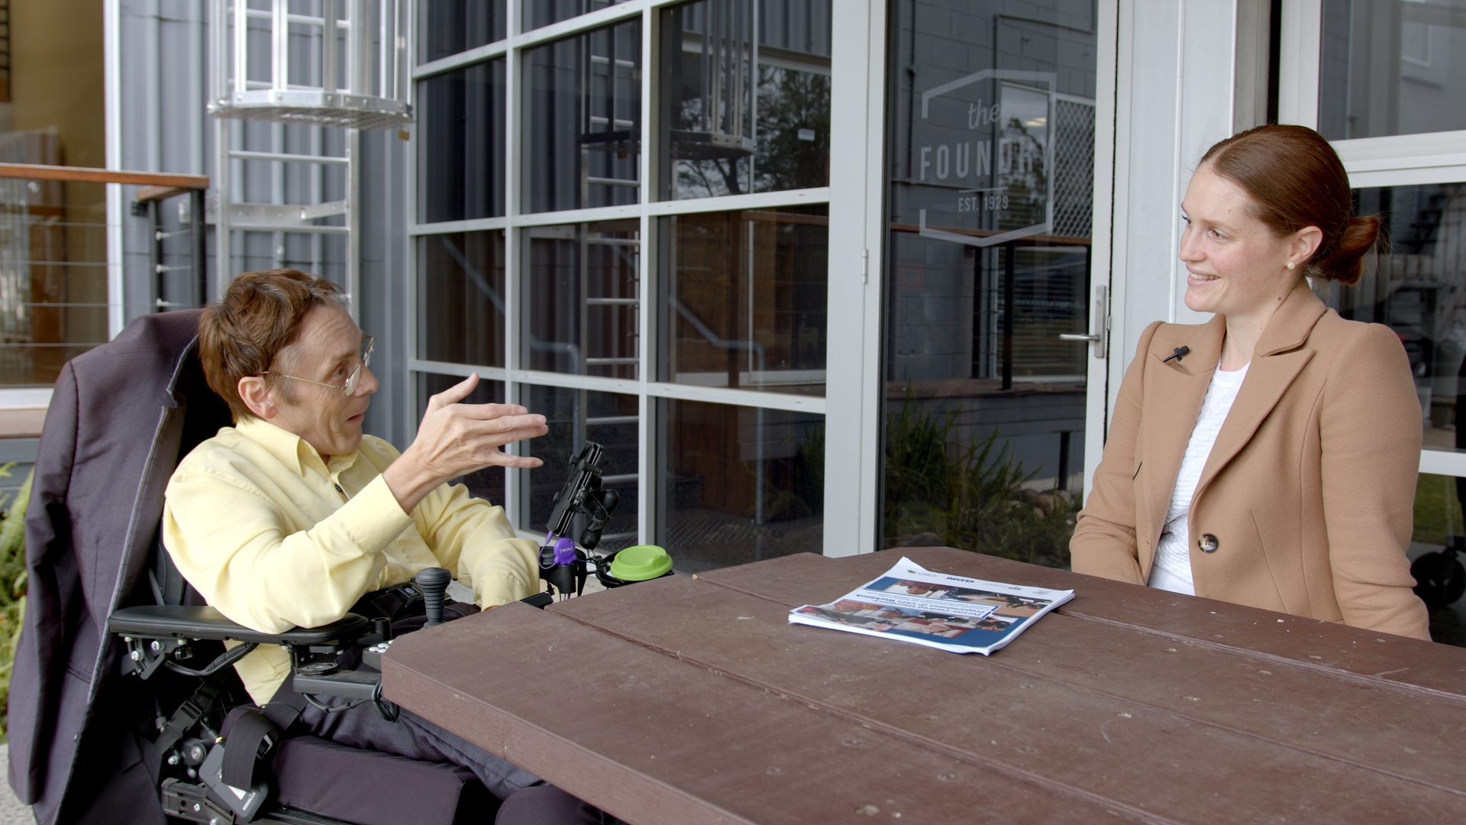
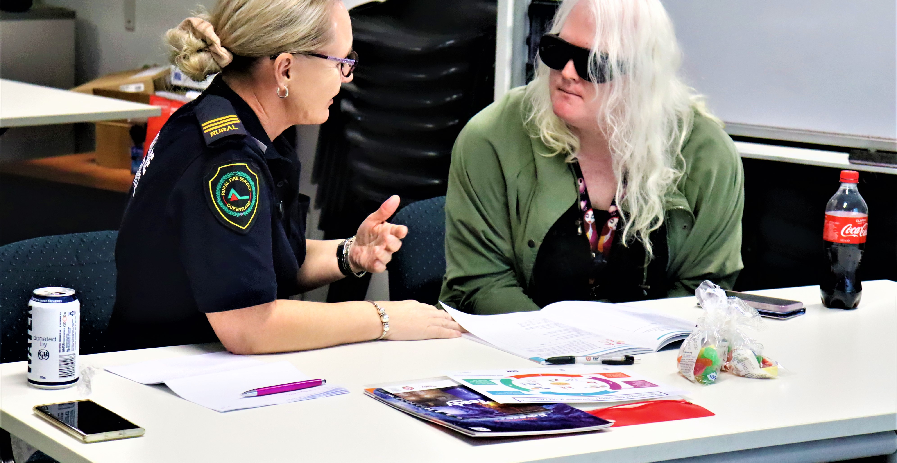
People with disability experience higher demands and fewer choices
This increases risk to
safety and wellbeing in emergencies
Notes:
People with disability experience higher demands and fewer choices which increase risk to safety and well-being in emergencies. Research has shown the disproportionate impact of disaster for people with disability who:
are two to four times more likely to die in a disaster than the general population
experience higher risk of injury and loss of property
have greater difficulty with evacuation and sheltering
require more intensive health and social services during and after disaster and take longer to recover.
The best way to mitigate this risk is to include people with disability in local disaster risk reduction from the beginning.
Problems for people with disability during recovery stem from the fact that they are overlooked in emergency management planning, response drills, and recovery planning/exercises. This means that emergency personnel lack information about:
how prepared people with disability are for emergencies
what they can do for themselves before, during and after disaster
what they need support for.

Slide 5
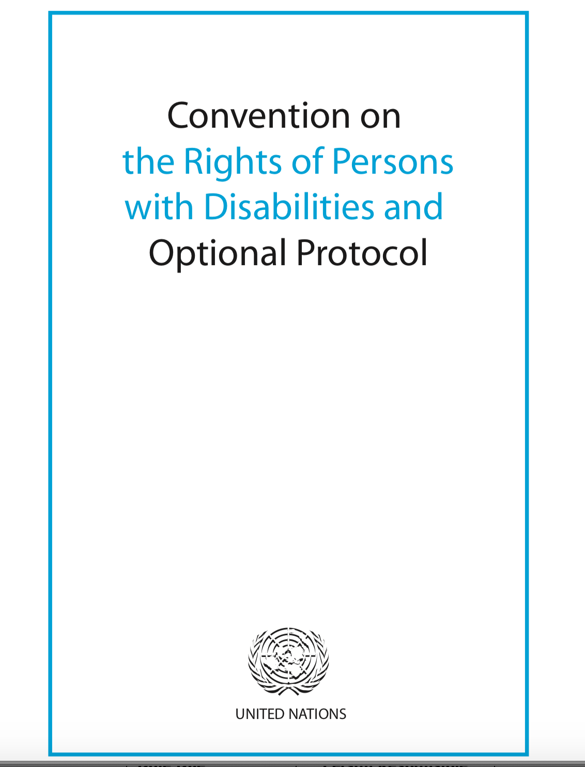
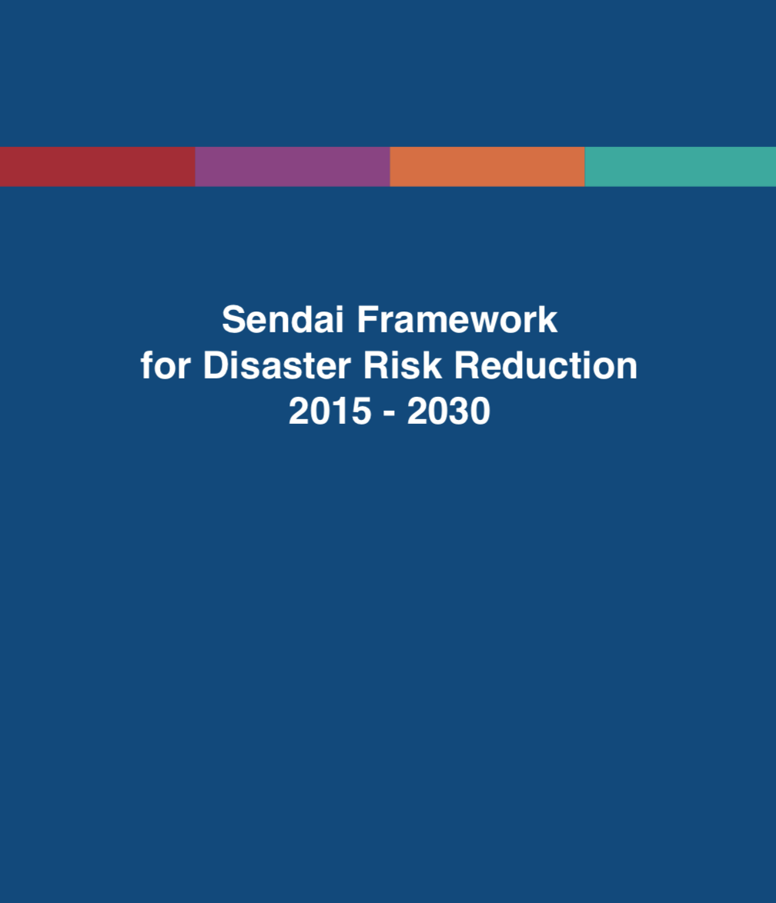
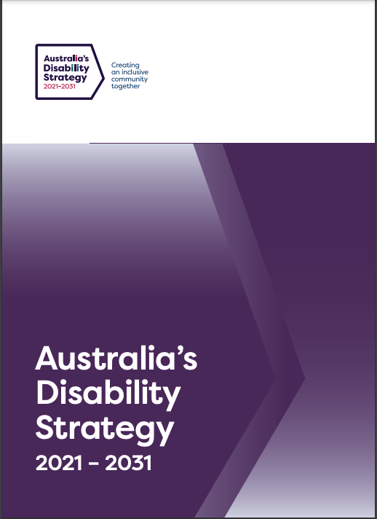
International and National Policy Frameworks
Notes:
Including people with disability and their representative organisations as legitimate stakeholders in emergency and recovery planning is a planning requirement, not an optional extra.
Australia, as a signatory to the United Nations Convention on the Rights of Persons with Disabilities (UNCRPD) and the Sendai Framework for Disaster Risk Reduction (SFDRR) has to find ways to ensure everyone is well prepared for disasters triggered by natural hazards. This includes people with disability and their support networks.
United Nations Convention on the Rights of Persons with Disabilities (UNCRPD)
Disability became prominent in the disaster policy agenda after the United Nations Convention on the Rights of Persons with Disabilities (UNCRPD) entered into force in 2008.
Article 11 of the UNCRPD requires nations to take all necessary measures to protect the safety of persons with disability in situations of risk, including disasters triggered by natural hazard events.
The UNCRPD also reinforces the right of people with disability to have equal access to programs and services that all citizens enjoy. This includes emergency preparedness and disaster risk reduction programs and services.
Sendai Framework for Disaster Risk Reduction (SFDRR) (2015-2030)
Built on the foundations of the UNCRPD, the Sendai Framework for Disaster Risk Reduction (SFDRR) (2015-2030) firmly established people with disability and their representative organisations as legitimate stakeholders in the design and implementation of disaster risk reduction policies (Stough & Kang, 2015), calling for “a more people-centred preventative approach to disaster risk” (p.5).
People-centred approaches place people and their needs at the centre of responsive disaster management and also position them as the main agents of development and change (Villeneuve, 2020).
Australia’s Disability Strategy 2021-31
This strategy includes, for the first time, targeted action on disability-inclusive emergency management and disaster recovery planning. This is significant because it requires all governments, community organisations, and businesses to include people with disability in their emergency management and disaster response and recovery planning.
This means that:
everyone must find effective ways to include the voices and perspectives of people with disability in planning and decision-making to increase the health, safety, and well-being of people with disability before, during, and after disasters.
emergency and recovery planning should include the services that support people with disability as a local community asset for emergency planning and recovery. Planning for emergencies must extend to working with disability service providers to help them to understand their disaster risks and make effective plans for their services, staff, and the people they support.
government and emergency services need to find ways to work in partnership with people with disability and the services that support them – because disability-inclusive emergency planning and disaster recovery require collaborative effort.

Slide 6
Associate Professor Michelle Villeneuve
Notes:
Associate Professor Michelle Villeneuve is Deputy Director, Centre for Disability Research and Policy at The University of Sydney. Michelle’s international program of research addresses inequities that people with disability experience in everyday living and situations of natural hazard disaster, and other emergencies
In this video, Associate Professor Michelle Villeneuve shares her wisdom on the importance of planning for emergencies with people with disability and the organisations that support them, and the things that are important to consider in planning for recovery.
ACTION: You need to be in slide show view to click on the link to the video
Video: Disability Inclusive Recovery Planning and Arrangements
Video length 6 minutes
ACTION: Whole group reflection question and discussion - spend a few minutes reflecting in group whole group discussion.
What are the key messages from Michelle’s video?

Slide 7
Key organisations to involve in disability inclusive planning
Some organisations are particularly well-positioned to play a key role.
They are:
Disabled People's Organisations (DPO)
Community services and disability support organisations
Emergency personnel, including volunteers
Local Government
Notes:
Key roles of different organisations in disability inclusive planning
Some organisations are particularly well-positioned to play a key role. They are:
Disabled People's Organisations (DPO)
Community services and disability support organisations
Emergency personnel, including volunteers
Local Government

Slide 8

Disabled People’s Organisations
Notes:
What is a Disabled People’s Organisation?
Disabled People’s Organisations (DPO) are led by and for people with disability.
Following the International Year of Disabled Persons (1981), DPOs emerged to advance the rights, empowerment, and self-determination of people with disability. DPOs can represent the voices of people with disability.
The fundamental difference between DPOs and other disability sector organisations is that DPOs are driven by people with disability (at least 51% representation at both the board and membership levels). Their purpose is to serve and represent their members with disability.
Role of DPOs
DPOs and their members can play a significant role in disaster policy, planning and community-level preparedness.
Through their lived experience and leadership roles as disability advocates, DPOs represent the voices and perspectives of their members with disability.
DPOs have:
in-depth understanding of the factors that increase risk for people with disability in emergencies.
access to informal networks of support and communication.
Who are the DPOs in your area?

Slide 9
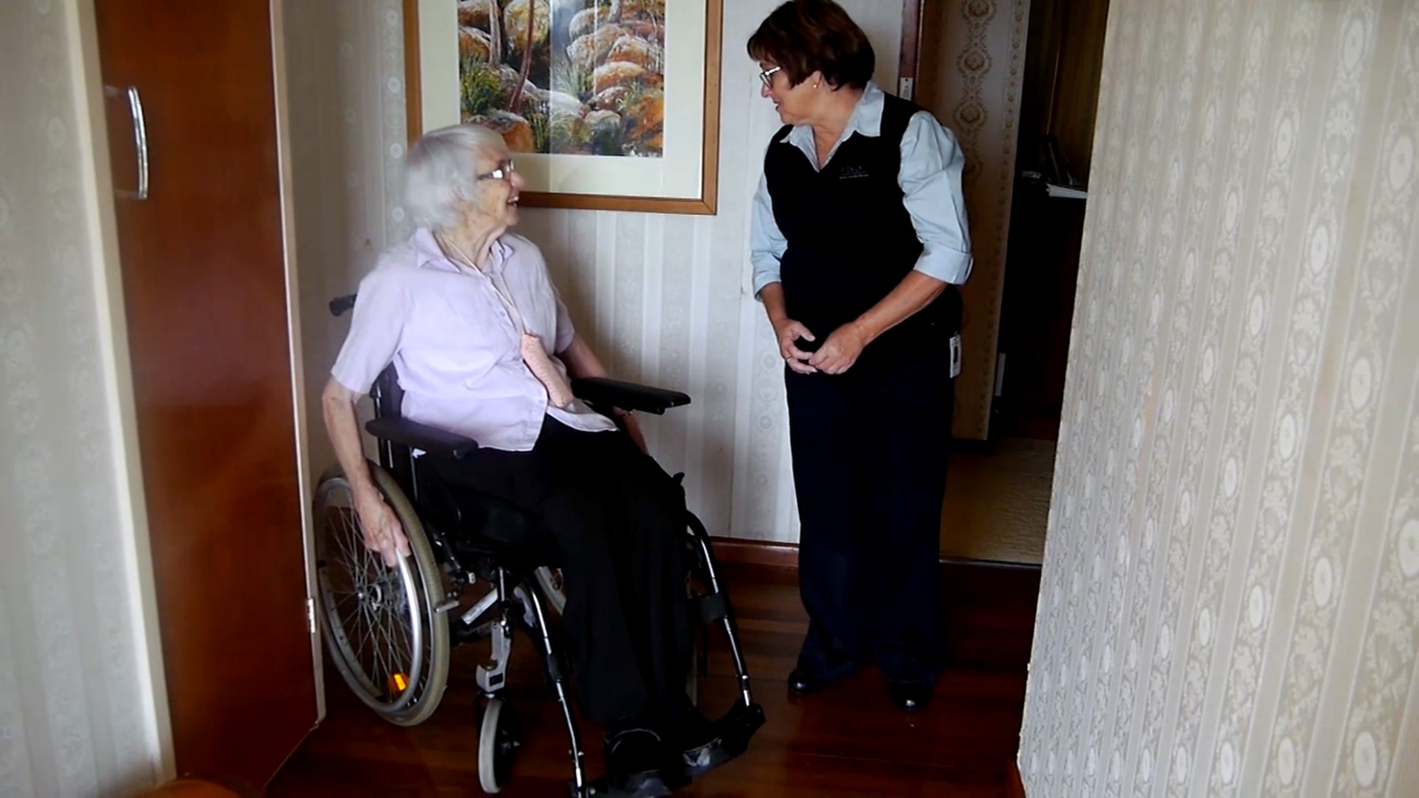
Community, health, and disability support organisations
Notes:
Community, health, and disability support organisations
Community, health, and disability support organisations are a local community asset with the potential to increase safety and well-being for people with disability in emergencies. Recent research has recognised the interdependence of people with disability and their support providers in achieving safety and wellbeing before, during and after disaster.
Disability service organisations can represent the voices of service providers in emergency planning
Play a significant role in disaster policy, planning and recovery arrangements. They are in an optimal position to facilitate person-centred emergency preparedness (PCEP) with their clients to support the development of local emergency and recovery plans because they have:
in-depth knowledge of the individual clients they serve, their functional capabilities and support needs, their family and community context
pre-existing relationships with clients and their family/social networks
local area knowledge of the community
have access to informal networks of support and communication
Community, health, and disability support organisations can increase safety and well-being for people with disability in emergencies by:
making sure that everyone they support has a personal emergency plan; and
having a business continuity plan for how to maintain services and supports during times of emergency. Community and disability support organisations are harnessing this potential.
Who are the disability service organisations in your area?

Slide 10
Disability service organisations can represent the voices of service providers in emergency planning.
Disabled People’s Organisations (DPO) can represent the voices of people with disability.
Remember this when reviewing your emergency plans. You may have consulted with services and advocacy organisations, but has your planning process included meaningful participation of DPOs?
This information is needed for community level emergency management and disaster recovery planning.
Notes:
Disability service organisations can represent the voices of service providers in emergency planning.
Only DPOs and people with disability, can represent the voices of people with disability.
Remember this when you are reviewing your emergency plans. You may have consulted with services and advocacy organisations, but has your planning process included meaningful participation of DPOs?
This information is needed for community level emergency management and disaster recovery planning but is not readily available to emergency personnel.
Person Centred Emergency Preparedness Resource Package: https://collaborating4inclusion.org/disability-inclusive-disaster-risk-reduction/p-cep-resource-package/

Slide 11
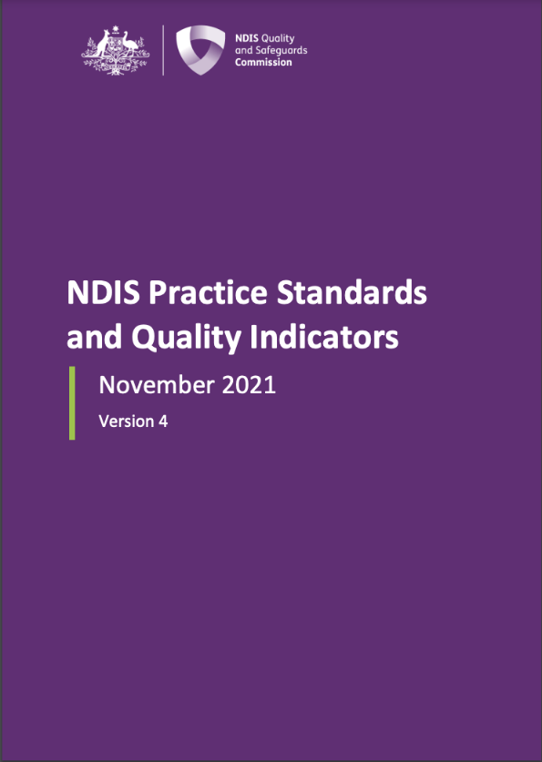
NDIS Practice Standards
The emergency and disaster management practice standard applies to existing registered NDIS providers from January 2022.
It will take time for NDIS providers to develop their capabilities and confidence in emergency and disaster management planning with the people they support.
Strong relationships need to be built between the emergency management sector and disability service providers.
It is important that the NDIS Legislation doesn’t become a tool to shift responsibility from the emergency sector over to services; this legislation is a tool to support Australia’s vision and objectives for responsibility sharing.
Notes:
In November 2021The NDIS Quality and Safeguarding Commission signed a legislative amendment to the NDIS Practice Standards.
This amendment requires all National Disability Insurance Scheme (NDIS) registered service providers to ensure that support plans include personal emergency preparedness and service continuity planning that supports the health, safety and well-being of the people they support. This includes ensuring continuity of supports which are critical to the safety, health, and wellbeing of NDIS participants before, during and after a disaster and working with their clients to undertake risk assessments and include preparedness strategies within their individual support plans.
This is a new responsibility for service providers and it will take time for them to develop their capabilities and confidence in emergency and disaster management planning with the people they support. It will require strong relationships to be built between the emergency management sector and disability service providers.
It is important that the NDIS legislation doesn’t become a tool for the emergency sector to shift responsibility over to services.
This legislation is a tool to support Australia’s vision and objectives for responsibility sharing.

Slide 12
Supporting disability service providers
Emergency Management Committees have a responsibility to support DPOs and service providers to develop their knowledge and capability through understanding:
Local disaster risks and how they can impact on their service and the people they support.
What makes good organisational and service continuity plans that ensure duty of care to staff and people they support.
How emergency management arrangements operate.
Notes:
The emergency management sector has a responsibility to ensure that emergency and recovery planning includes the services that support people with disability as local community assets for emergency planning and recovery. It also means that planning for emergencies must extend to working with disability service providers to help them understand their disaster risks and help them to make effective plans for their services, staff, and the people they support.
What are some practical ways to support this?

Slide 13
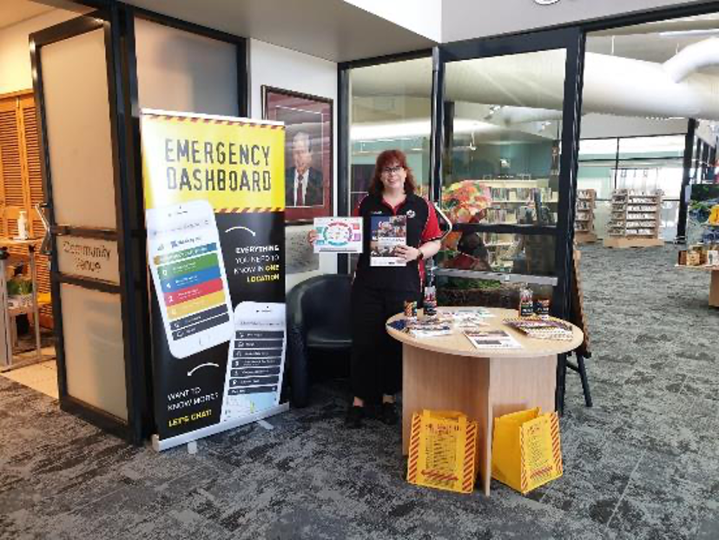
Role of Local Government
Notes:
Councils have excellent links to community groups that are crucial to building resilience for people with disability before, during and after disaster.
They can use these linkages to increase inclusion for people with disability and the services that support them in emergency and recovery planning.

Slide 14
Role of emergency and recovery planners and committees
Recovery planning must make sure that recovery services and supports are inclusive of people with disability.
This may require extra planning for how recovery services will connect up with mainstream community and disability services.
Recovery services and supports must ensure equitable access for people with disability on par with the rest of the community impacted by disaster.
Notes:
Emergency Management Committees develop emergency plans to keep their whole community safe when disaster strikes. These plans must include people with disability and their support needs, otherwise people with disability will get left behind when council enacts their plan. Local emergency plans must take into consideration the extra supports that people with disability need and how they will be organised and delivered in emergencies.
Understanding how people with disability and the services that support them navigate care, services, and support before a disaster is a good starting point for making sure that they have continuous access to those supports after a disaster.
Recovery planning must make sure that recovery services and supports are inclusive of people with disability. This may require extra planning for how recovery services will connect up with mainstream community and disability services (formal/paid services and supports which may have been impacted by the same disaster).
If people with disability are not included in the planning process they will be left behind in recovery.
Planning for recovery services and supports (e.g., health and well-being, case management, community development, recovery support, etc.) must ensure equitable access for people with disability on par with the rest of the community impacted by disaster.

Slide 15
Involving disability providers in emergency and recovery planning
Emergency and recovery planners need to involve service providers IN emergency management and recovery planning.
This includes considering how to best communicate with and advocate for the needs of people at greatest disaster risk, so that their needs are considered across all stages of planning for responding to and recovering from disasters.
If people with disability are not included in the planning process, they will be left behind in recovery.
Notes:
Emergency Management Committees have a responsibility to support DPOs and service providers in understanding emergency and recovery arrangements.

Slide 16
Inclusive emergency management planning
It is always better to have planning conversations to co-design approaches to inclusive emergency management and disaster recovery before disaster hits, however after a disaster, these questions are a good starting point
What was the impact of the disaster on people with disability?
What could have been done differently to improve the situation?
Do people with disability have equitable access to disaster recovery information, services, supports?
What is the impact of recovery services on the safety and well-being of people with disability recovering from disaster?
How can we make sure that people with disability have the services they need?
Notes:
Planning conversations to co-design approaches to inclusive emergency management and disaster recovery can start at any time, preferably before a disaster and also as part of recovery planning after a disaster.
After a disaster, these questions are a good starting point for conversations with people with disability and the organisations who represent them to plan for recovery: New questions can and should be added to strengthen planning conversations as they develop.
These questions can be found in Associate Professor Michelle Villeneuve’s Issues Paper which brings together lived experience and literature to build a picture of the roadblocks to safety and wellbeing for Australians with disability and puts forward a suite of practical actions that institutions with responsibility for emergency management and other stakeholders can undertake. The ‘Questions to Ask’ are included in this paper on page 25.
Villeneuve, M. (2021). Issues Paper: Clearing a path to full inclusion of people with disability in emergency management policy and practice in Australia. Centre for Disability Research and Policy. The University of Sydney, NSW, 2006. http://www.daru.org.au/resource/clearing-a-path-to-full-inclusion-of-people-with-disability-in-emergency-management-policy-and-practice-in-australia.

Slide 17
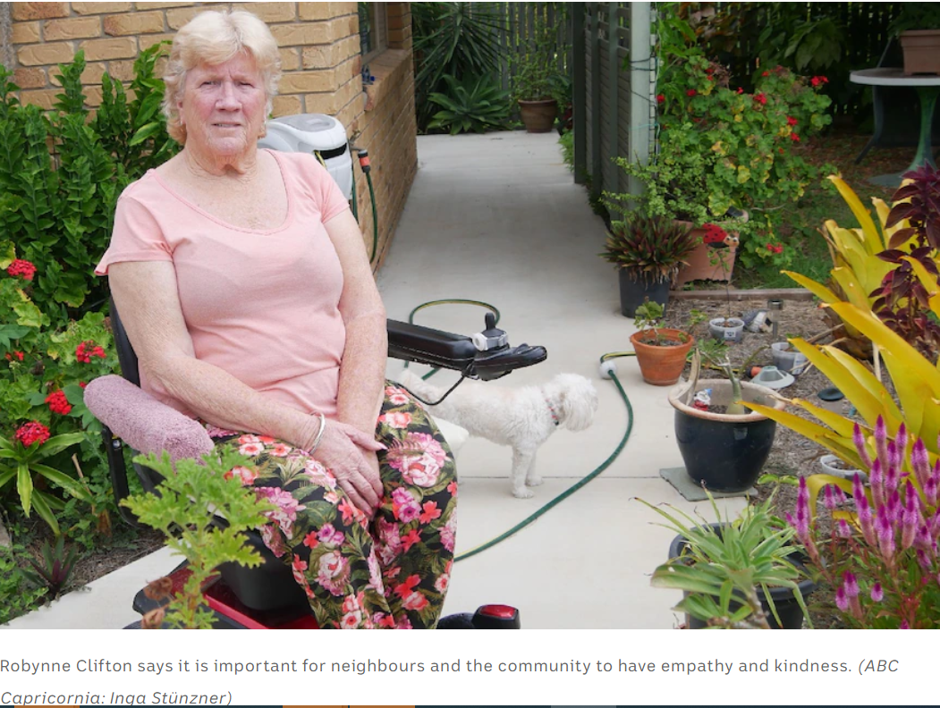
Case Study: Robynne was forgotten after a cyclone
"I was stuck in my lounge room for four days, with no food, no water and no way of getting to the bathroom," Robynne Clifton said.
"It was devastating. I just wanted to forget about living."
Cyclone Marcia hit the central Queensland coast as a Category 5 storm on February 22, 2015, leaving a trail of destruction. The city was left without telephone connections and electricity for eight days.
For Ms Clifton, who has post-polio syndrome, the ordeal is still raw. She has been relying on her wheelchair since 2013, soon after her husband passed away. During the emergency, no one came to check on her.
"I thought, how could anybody be so cruel," she said.
Notes:
Robynne Clifton was stuck in her wheelchair for four days and forgotten after a cyclone.
ACTION: Read through the case study on the next three slides with the group as a lead into the discussion activity
The article can be found here: https://www.abc.net.au/news/2022-02-03/robynne-clifton-stuck-in-wheelchair-for-four-days-after-cyclone/100799942

Slide 18
Turned away from evacuation centre and hospital
In the lead up to the cyclone, Ms Clifton's carer told her to relocate to the local evacuation centre, which would keep her safe.
Ms Clifton was told by the centre's staff that they did not have the experience to move her from her wheelchair and lower her into a bed.
So she returned home and sat out the cyclone in her bathroom.
"It was very scary."
Ms Clifton's one link to the outside world, a medical alert system, relied on power and then a battery, which ran out.
After four days and no sign of anyone coming to check on her, Ms Clifton said she called the ambulance for help.
The paramedics took her to hospital, but a nurse turned her away because she was not injured or sick.

Slide 19
Her ordeal did not stop there
When the power returned and Ms Clifton was able to power up her wheelchair, she travelled five blocks to a centre distributing water.
She was turned away because she did not live in that local government area; she lived just outside its border.

Slide 20
Case Study Discussion Reflecting on Robyn’s experience: How will you make sure that people with disability have access to recovery services and supports? What are your experiences? What are the opportunities? What are the challenges? What local organisations/assets can support you?
Notes:
ACTION: Break Out Group Discussion Questions
ACTION: Break into table group discussions for 20mins
ACTION: Leave this slide on screen for people to refer to.
How will you make sure that people with disability have access to recovery services and supports?
(e.g., evacuation centres/recovery hubs; community meetings; case management support; community development; mental health recovery; transportation; water/food/power; health and social well-being/recovery committees, etc.)
What are your experiences?
What are the opportunities?
What are the challenges?
What local organisations/assets can support you?
ACTION: Have each group report back on their key learnings and discuss as large group plenary for 10 minutes.

Slide 21
Good practice tips for Recovery Committees
Disabled People’s Organisations (DPOs) can play a significant role in disaster policy, planning and interventions by representing their members and allowing their voices to be heard.
Know the Disabled People’s Organisations and the Disability Support Organisations in your area and connect with them.
Include disability representation and/or links to community services reference groups on your recovery committee and in your planning.
Review emergency and recovery plans to make sure people with disability and their extra support needs are included.
Make sure that emergency and recovery plans are accessible for people with disability.
Notes:
People with disability have the right to know what plans are in place for managing emergencies in their community.
This information is available to everyone by accessing their Local Council’s emergency management plan. If the plan is hard to access or not accessible, this provides an opportunity for dialogue with Council emergency managers about ways to improve the accessibility of those plans for people with disability. It enables mutual learning to support responsive emergency management planning practices and individual preparedness capabilities.
Villeneuve, M. (2021). Issues Paper: Clearing a path to full inclusion of people with disability in emergency management policy and practice in Australia, P31. Centre for Disability Research and Policy. The University of Sydney, NSW, 2006. http://www.daru.org.au/resource/clearing-a-path-to-full-inclusion-of-people-with-disability-in-emergency-management-policy-and-practice-in-australia.

Slide 22
Take away messages
People with disability are among the most neglected during disaster events, with particularly restricted access to social networks and other sources of support.
Including people with disability and their representative organisations as legitimate stakeholders is a planning requirement, not an optional extra.
People with disability must be included in the development of emergency and recovery plans, otherwise they will get left behind in a disaster.
Disabled People’s Organisations can play a significant role in disaster policy and planning, helping their members voices to be heard.
Emergency and recovery plans must consider the extra supports that people with disability need and how they will be organised and delivered in emergencies.

Slide 23
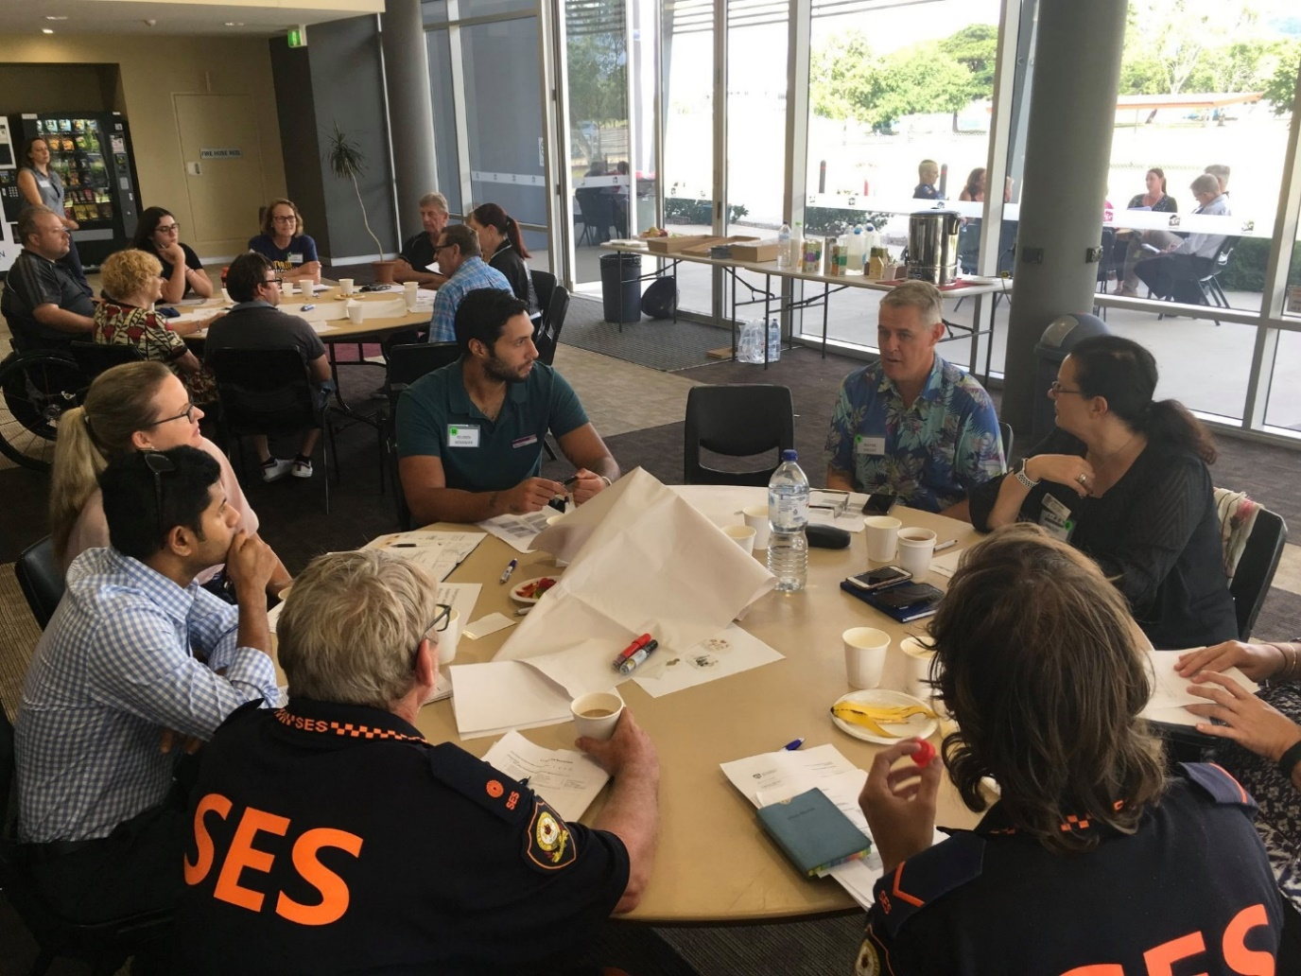
Disability Inclusive Disaster Risk Reduction (DIDRR)
Notes:
Disability Inclusive Disaster Risk Reduction (DIDRR) means making sure that the needs and perspectives of people with disability and the people who support them are included in all stages of emergency management: preparedness, response, and recovery.
Tools and resources to help you include people with disability in emergency management planning can be found at:
Collaborating 4 Inclusion | Collaborating for inclusion of people with disability in the community.
The strategies that we use in DIDRR to make things inclusive for people with disability will also help in planning with other groups also at risk in emergencies, including older people, people facing homelessness, and socially disconnected people.
Problems for people with disability during recovery stem from the fact that they are overlooked in emergency management planning, response drills, and recovery planning/exercises. This means that emergency personnel lack information about:
How prepared people with disability are for emergencies?
What they can do for themselves before, during and after disaster?
What they need support for?

Slide 24
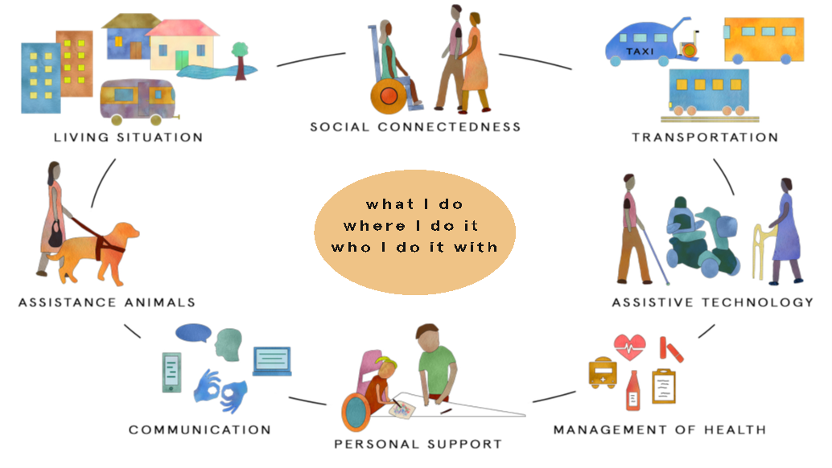
Person-Centred Emergency Preparedness Framework (Capability Wheel)
Notes:
The Person-Centred Emergency Preparedness (P-CEP) Tookit provides guidance and tools for local councils and emergency services personnel to assist in planning for the support needs of people with disability. https://collaborating4inclusion.org/disability-inclusive-disaster-risk-reduction/p-cep-resource-package.
If we can understand what people with disability can do for themselves and the extra support need they have following a disaster, then we can better plan for recovery supports and services that are matched to their support needs and situation. This also means understanding how they manage their support needs everyday and the people/services they rely on – and whether and how those services are impacted by disaster.
The Person-Centred Emergency Preparedness (P-CEP) Framework uses the ‘capability wheel’ to help us think and plan differently for the support needs of people with disability in emergency management and disaster recovery planning. The capability wheel guides self-assessment and tailored emergency preparedness planning in eight different areas.

Slide 25
Person-Centred Emergency Preparedness
Learn about Person-Centred Emergency Preparedness and host workshops to begin P-CEP conversations in your community in partnership with people with disability.
Contact michelle.villeneuve@sydney.edu.au
or
Queenslanders with Disability Network: qdn.org.au/our-work/disability-inclusive-disaster-risk-reduction

Slide 26
Suggested next steps
Invite a disability representative to speak to your emergency management/ recovery committee or Local Disaster Management Group about DIDRR.
Include people with disability in emergency planning by forming a working group or community of practice that brings together people who have a shared interest in disability inclusion.
Review all emergency management documents for accessibility. This helps everyone to learn about and understand their disaster risks.
Review your emergency and recovery plans – how is planning for people with disability and their extra support needs included in your emergency and recovery planning processes?
What are the strengths?
What are the areas for improvement?
What else do you need to do?
What DPO in your community can you reach out to for support?

Slide 27
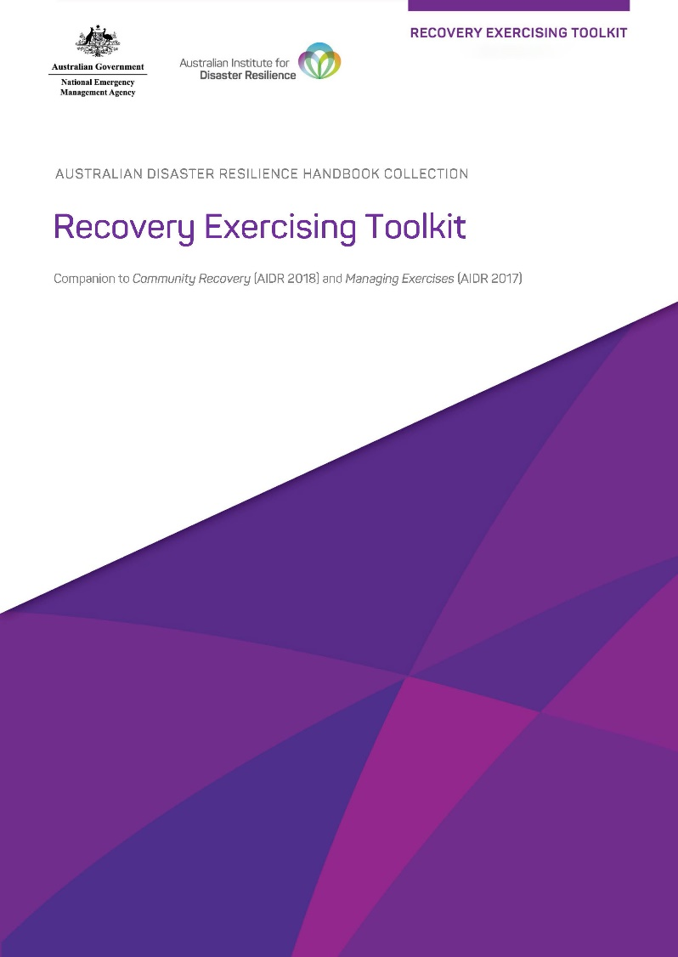
Recovery Exercising Toolkit
The Supporting People with Disability in Recovery Module Overview, Slide Deck and other resources are available in the Recovery Exercising Toolkit which can be found on the AIDR Knowledge Hub in the Recovery Collection.
Notes:
The content contained in this module is available in the Recovery Exercising Toolkit: https://knowledge.aidr.org.au/resources/recovery-exercising-toolkit/
Encourage participants to access the information through the Toolkit and to explore what else the Toolkit has to offer to help build recovery capability in their committees and agencies.

Slide 28
Where to find out more
Collaborating 4 Inclusion Person-Centred Emergency Preparedness (P-CEP) Resource Package collaborating4inclusion.org/disability-inclusive-disaster-risk-reduction/p-cep-resource-package
Villeneuve, M. (2021) Issues Paper: Clearing a path to full inclusion of people with disability in emergency management policy and practice in Australia. Centre for Disability Research and Policy. The University of Sydney, NSW, 2006. www.daru.org.au/resource/clearing-a-path-to-full-inclusion-of-people-with-disability-in-emergency-management-policy-and-practice-in-australia

Slide 29
Disability Inclusive Disaster Risk Reduction (DIDRR) in action
Ipswich City Council: Listening and learning from people with disability collaborating4inclusion.org/wp-content/uploads/2021/08/CaseStudy_7_FINAL.pdf
Rockhampton’s Inclusive Risk Assessment collaborating4inclusion.org/wp-content/uploads/2021/08/CaseStudy_8_FINAL.pdf
Taking disability out of the too hard basket collaborating4inclusion.org/wpcontent/uploads/2021/10/Research_in_Brief_3_FINAL-Taking_Disability_out_of_the_Too_Hard_Basket.pdf

